Slide 1
Travelling Salesman optimization problem Using Simulated Annealing
TEAM MEMBERS:​
S.J SUMANTH (2010030377)​
K. SREEVARUN (2010030451)​
E. PAVAN SAI (2010030538)​
E. SHIVA GOUD (2010030542)

Slide 2
Outline
Introduction
Literature Survey
Dataset
Implementation Steps
Conclusion
Problem Statement

Slide 3
Introduction
With the development of Big Data technology, graphics computing is applied to all kinds of fields. For example, an entire social network is a graph in which the user is the vertex of the graph, and the relationship between the user and another user is regarded as the edge. As can be seen from the above example, as a storage or presentation form in a specific application, how to mine the knowledge contained in a graph by quickly traversing the vertices in the graph is a research hotspot in the field of graphics computing.
Traversing all the vertices in the graph and repeating is an important application direction in graph-vertex traversal. Traversing all the vertices in the graph is a classical traveling-salesman problem (TSP) in the shortest time. It is well known that TSP is an NP-hard problem .To solve the problem, besides traditional backtracking algorithms, branch-and-bound algorithms, and greedy algorithms, we mainly use heuristic search algorithms to optimize. These heuristic algorithms include the simulated annealing algorithm, tabu-search algorithm, ant-colony optimization algorithm ,and genetic algorithm.

Slide 4
Literature Survey
S.No | Title | Author | Journal and Year | Accuracy | Scope | Link
1 | Simulated Annealing for Traveling Salesman Problem with Hotel Selection for a Distribution Company Based in Mexico | Raul Jimenez-Gutierrez, Diana Sanchez-Partida, Jose-Luis Martínez-Flores, Eduardo-Arturo Garzon-Garnica | ASTES - 2020 | 24.44% improvement over the current route selection | Using more precise mathematic models to find the relationship between the distance and the travel time can improve the efficiency. | https://astesj.com/v05/i05/p62/
2 | The application of simulated annealing method for optimal route detection between objects | Peter Grabustsa, Jurijs Musatovs, Vladimir Golenkov | Elsevier -2019 | SA algorithm can be successfully applied in various optimization tasks | Enhancement of the proposed algorithm in order to get the optimal solution | https://www.sciencedirect.com/science/article/pii/S187705091930119X

Slide 5
Literature Survey
S.No | Title | Author | Journal and Year | Accuracy | Scope | Link
3 | Traveling-Salesman-Problem Algorithm Based on Simulated Annealing and Gene-Expression Programming | Ai-Hua Zhou Li-Peng Zhu, Bin Hu, Song Deng , Yan Song and Hongbin Qiu and Sen Pan | MDPI - 2018 | The best solution obtained by TSP-SAGEP is the closest to the optimal solution | Enhancement of the proposed algorithm in order to better solve the problem of large-scale graph vertex traverse | https://www.mdpi.com/2078-2489/10/1/7
4 | Optimization of Multiple Traveling Salesman Problem Based on Simulated Annealing Genetic Algorithm | Mingji Xu, Sheng Li and Jian Guo | MATEC Web Conf. - 2017 | Simulated Annealing Algorithm iterates faster | Enhancement of the local search ability to achieve a better global optimum solution | https://www.matec-conferences.org/articles/matecconf/abs/2017/14/matecconf_gcmm2017_02025/matecconf_gcmm2017_02025.html

Slide 6
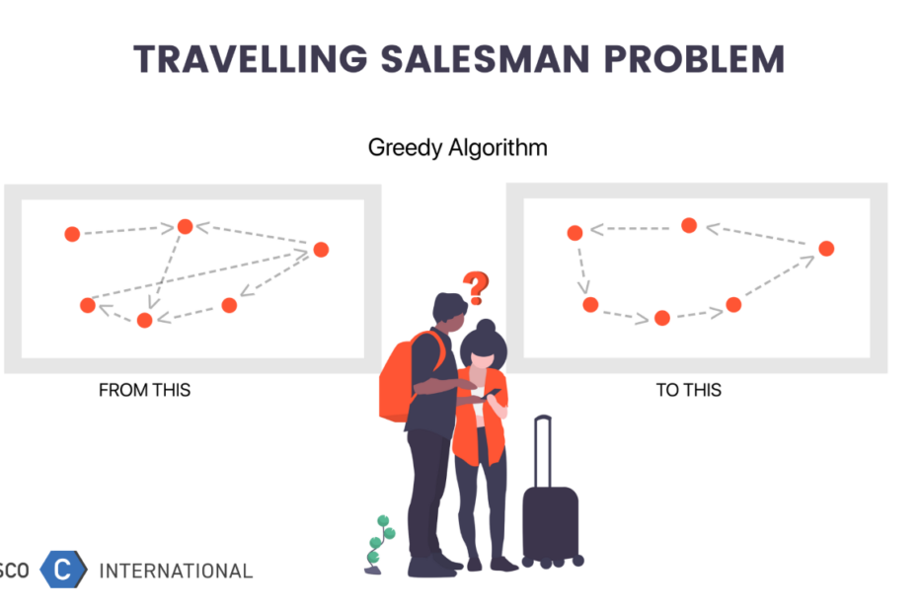
Problem Statement
The traveling salesman problem (TSP) using simulated annealing is a algorithmic problem tasked with finding the shortest route between a set of points and locations that must be visited.
The salesperson should travel from one point and visit all the required cities/point and return to the start point with shortest path and visiting of same point should note be repeated.

Slide 7
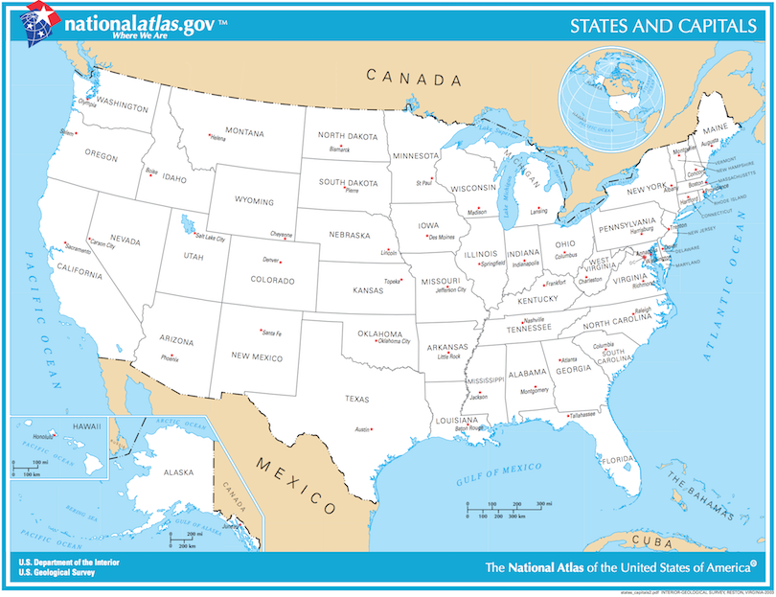
Dataset
We have downloaded the dataset from Kaggle
We are using python language to implement this project
We are using Simulated Annealing algorithm to find the optimal path

Slide 8
Implementation Steps
Step 1:
Start with a random tour through the selected cities. Note that it’s probably a very inefficient tour!
Step 2:
Pick a new candidate tour at random from all neighbors of the existing tour. This candidate tour might be better or worse compared to the existing tour, i.e. shorter or longer.
Step 3:
If the candidate tour is better than the existing tour, accept it as the new tour.

Slide 9
Implementation Steps
Step 4:
If the candidate tour is worse than the existing tour, still maybe accept it, according to some probability. The probability of accepting an inferior tour is a function of how much longer the candidate is compared to the current tour, and the temperature of the annealing process. A higher temperature makes you more likely to accept an inferior tour.
Step 5:
Go back to step 2 and repeat many times, lowering the temperature a bit at each iteration, until you get to a low temperature and arrive at your (hopefully global, possibly local) minimum. If you’re not sufficiently satisfied with the result, try the process again, perhaps with a different temperature cooling schedule.

Slide 10
Conclusion
There are many procedures to solve the travelling salesman problem like greedy method , branch and bound , dynamic programming , Simulated annealing , 2-opt algorithm.
Comparing all the results ,one of the approach “Simulated Annealing” gives the best optimal result though the 2-opt algorithm gives fast and best result.

Slide 11


